Slide 1
PL & FORWARD Meeting

Slide 2
Parameterized Query
Public list getNation(int key) {
List result = new ArrayList();
List nations = nationDao.getNations();
for (Nation n : nation) {
if (n.getNationKey() == key) {
result.add(n);
}
}
return result;
}
return db.executeQuery(
"SELECT n" +
"FROM Nations n" +
"WHERE n.nation_key == ?”, key);
Selection

Slide 3
Parameterized Query 2
getSumTotalForNation(Nation nation) {
int nationKey = nation.getKey();
List customers = customerDao.getCustForNation(nationKey);
List orders = orderDao.getAllOrders();
int sum = 0;
for (Customer c : customers)
for (Order o : orders)
if (c.getCustKey() == o.getCustRef())
sum += o.getTotalPrice();
return sum;
}
It is unclear how query synthesis handlers outer references
getSumTotalForNation(Nation nation) {
Return forward.executeQuery(
"SELECT sum(o.total_price) as sumTotal
FROM Orders o, Customers c
WHERE o.cust_ref = c.cust_key
AND c.nation_ref = ?", nation.getKey());
}
Notes:
The previous example was synthetic and unlikely in a real application, which would more likely use a parameterized function.

Slide 4
Query with Nesting
List findCoursesForStudents() {
List listSC = new ArrayList();
List students = query (“SELECT * FROM students“);
List enrollments = query (“SELECT * FROM enrollments”);
for (Student student : students) {
List cids = new ArrayList();
for (Enrollment enrollment : enrollments) {
if (student.sid == enrollment.sid) {
cids.add(enrollment.cid);
}
}
listSC.add(new StudentWithCids(student,cids));
}
return listSC;
}
Client Application Program
Rewrite to SQL++
return forward.executeQuery(“SELECT s, (
SELECT c.cid FROM Courses AS c
WHERE c.sid = s.sid) AS cids
FROM Students AS s;”);
Notes:
Pseudo code => make leaps of reasoning in how lists are populated

Slide 5
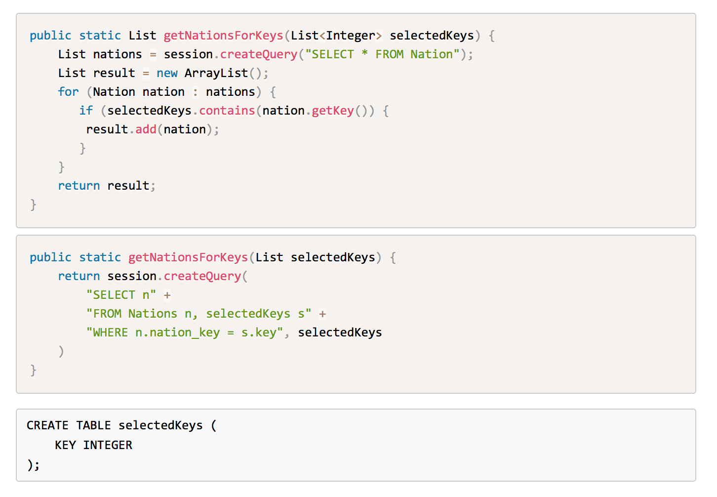
Session Objects

Slide 6
Complex Example
public List getSumTotal3Years(List selectedNations){
List sumTotals = new ArrayList();
Query query = session.createQuery(
"SELECT order_year, sum(o.total_price) as sumTotal\n"
+ "FROM Orders o, Customers c\n"
+ "WHERE o.cust_ref = c.cust_key\n"
+ "AND c.nation_ref = :nation\n"
+ "GROUP BY o.order_year\n"
+ "ORDER BY sumTotal DESC\n"
+ "LIMIT 3");
for (Nation nation : selectedNations) {
query.setInt("nation", nation.getNationKey());
List pairs = (Pair) q.list();
sumTotals.add(Pair.of(nation,pairs));
}
return sumTotals;
}
SELECT n.nation_key, n.name, (
SELECT order_year,
sum(total_price) as sum_price
FROM db.orders AS o,
db.customers AS c
WHERE o.cust_ref = c.cust_key
AND c.nation_ref = n.nation_key
GROUP BY order_year
ORDER BY sum_price
LIMIT 3
) AS aggregates
FROM session.selected_nations AS s,
db.nations AS n
WHERE s.nation_ref = n.nation_key
AND s.selected = true

